Slide 1

Let’s Speak About Superstitions
Module 1

Slide 2

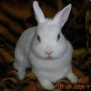
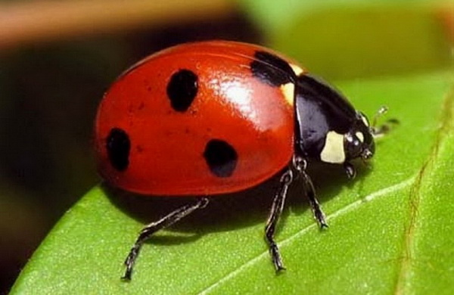
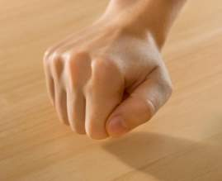
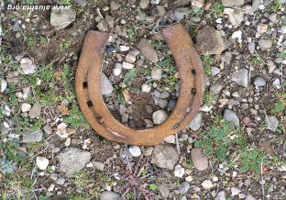
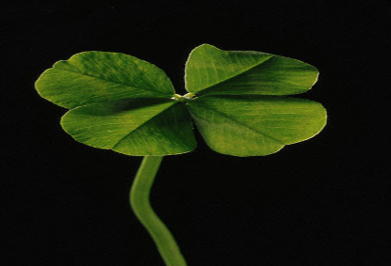
Good Luck

Slide 3
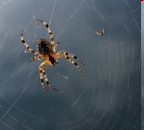
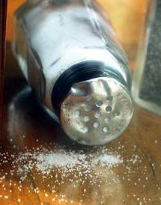
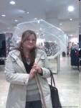


Bad Luck

Slide 4
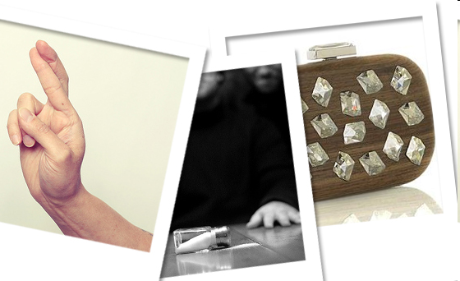
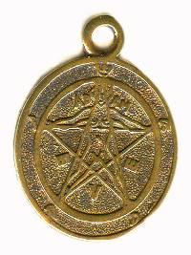
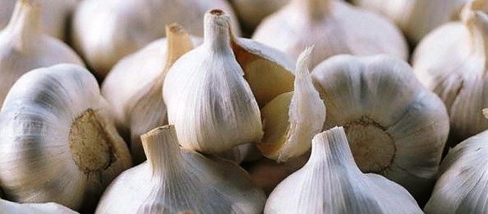
What do people do to protect themselves from bad luck.

Slide 5
Other Superstitions
AN APPLE A DAY KEEPS THE DOCTOR AWAY
FINDING A FOUR LEAF CLOVER IS GOOD LUCK
STEP ON A CRACK, BREAK YOUR MOTHER’S BACK
AT THE END OF A RAINBOW IS A POT OF GOLD
A RABBIT’S FOOT BRINGS GOOD LUCK
GARLIC PROTECTS AGAINST VAMPIRES
RUNNING AROUND THE HOUSE WITH LUGGAGE ON NEW YEAR’S WILL MAKE YOU TRAVEL MORE

